Slide 1
Public fraud and corruption in the Dutch Caribbean
Drs Nelly Schotborgh-van de Ven CFE

Slide 3
Politics

Slide 4
Politics
Should this be possible?
1. Yes, it is a fundamental right to be politically active.
2. No, a public official must at all times take a neutral image.
3. Otherwise.

Slide 5
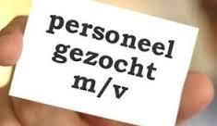
New colleague

Slide 6
New colleague
What are you going to do?
Nothing. I assume that management, together with HRM, does a reference check.
I inform the management.
Otherwise.

Slide 7
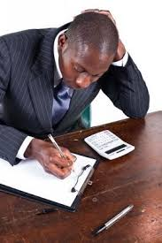
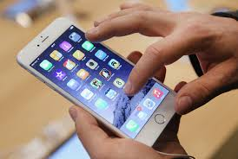
Juni ta un bon trahador

Slide 8
Juni ta un bon trahador
Should this be possible?
Yes, as long as he has done his job on time.
No, regular private activities on the phone are inappropriate on the workplace
Otherwise.

Slide 9
Relevant questions to vote
Who are the financiers of the political party? What are their interests?
Does the political party have house rules or a code of conduct on how the party members should behave? Are these rules also complied with?
How many heads does the politician wear? Are the side jobs, businesses and financial interests of the politician known?

Slide 10
Relevant questions to vote
4. Our politicians are important role models for our youth. Is the politician you are going to vote for a good example for your son/daughter?
5. Does the politician walk his/her talk?
6. Does the political party have ideas about how to change bad governance into good governance?

