Slide 1
Public fraud and corruption in the Dutch Caribbean
Drs Nelly Schotborgh-van de Ven CFE

Slide 2
Public fraud and corruption
The abuse of a public function for private gain
Public officers who benefit themselves, family, friends, political party, neighborhood…..
Public monies, goods, information, jobs, permits, services

Slide 3
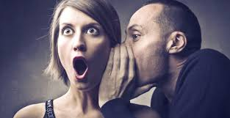
Bla, bla, bla, bla, bla…….

Slide 4
What is known?
2000 – 2015
46 cases of public fraud en corruption
Court of Appeal
Joint Court of Aruba, Curacao, Sint Maarten & Bonaire, St. Eustatius and Saba

Slide 5
Studied cases
Aruba 11
Curacao 22
Sint Maarten 11
Caribisch Nl 2

Slide 6
SECTOR | NUMBER OF CASES | %
JUSTICE | 18 | 39%
TRAFFIC, INFRASTRUCTURE, SPATIAL PLANNING | 6 | 13%
FINANCE | 6 | 13%
HEALTH AND ENVIRONMENT | 5 | 10%
ECONOMIC AFFAIRS AND TOURISM | 4 | 10%
DIFFERENT | 7 | 15%
TOTAAL | 46 | 100%
Sectors and organisations

Slide 7
PROCES | TOTAAL | %
Permits | 13 | 27
Procurement | 9 | 28
Checkpoints (drugs, contrabande) | 8 | 16
Financial management | 7 | 14
Appointments | 5 | 10
Checks on Import charges | 4 | 9
Cost expenses | 3 | 6
TOTAL | 51 | 100%
Organisational processes

Slide 8
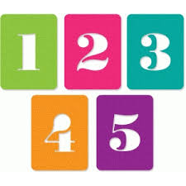
What went wrong????
Leadership
Procedures
Controls
Organizational culture
Integrity policy

Slide 9
1. Leadership
Type 1:
Leader is perpetrator (53%)
Leader is initiator
Dominant personality
Directive performance
Type 2:
Leader is not acting
Weak
No repercussions on integrity issues

Slide 10
2. Procedures
Some procedures could be improved
Procedures are there, but …were with full knowledge not applied….
No separation of duties in practice
Great decision-making power
Administrative reports are lacking

Slide 11
3. Control
Financial administration (often) not in place
(Financial) accountability afterwards… times later…. or not
1/3 of the cases: requests and warnings were ignored

Slide 12
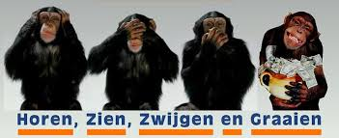
4. Organisational culture
Basic integrity standards are violated
Regular incidents
Gradually moral decay
Threats and reprisals (inside, outside)
Culture of:
- not interfering, powerlessness and looking away
- collective indifference

Slide 13
5. Integrity policy
Written integrity rules exist
Failure to comply with laws and regulations

Slide 14
Perpetrators

Slide 15
Individual characteristics
74% man, 15 % women, 11% both
Average age: 45 year
> 50% HBO- or University
Others: Professional education
Carrier > 20 years
Salary

Slide 16
Motives
‘Slippery slope’
Money
(Political) Power
Love

Slide 17
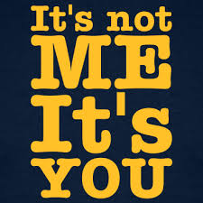
Accountability
Not my responsibility
Look to the others

Slide 18
Direction

