Slide 1
Corruption Awareness Campaign

Slide 3
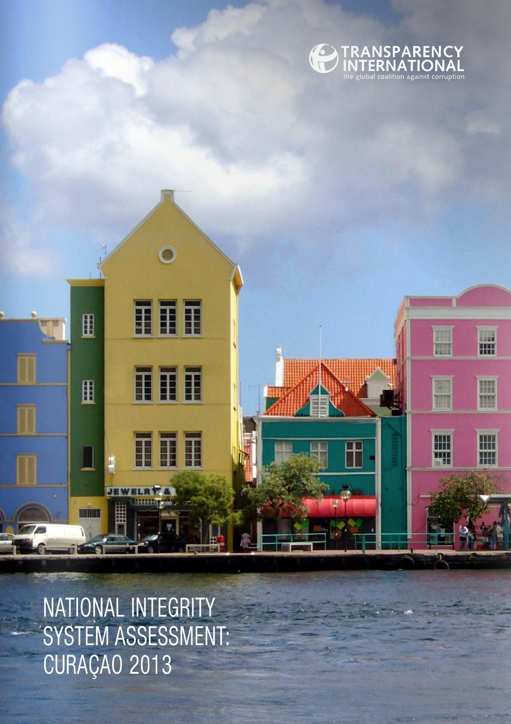
The start
Transparency International Report 2013
Ronde tafel gesprekken
Establishment of Korsou Transparente
Aim: follow-up of the recommodations
Awareness of the population is an important condition

Slide 4
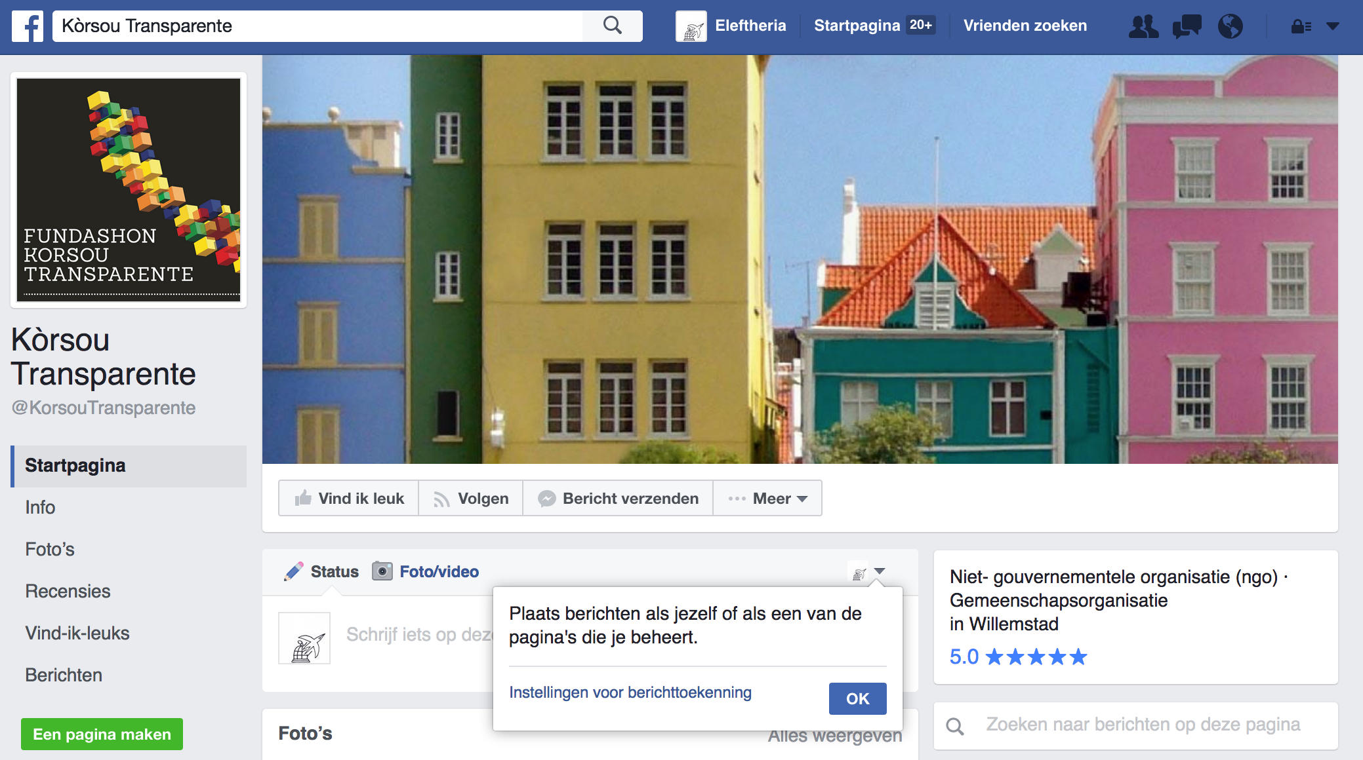
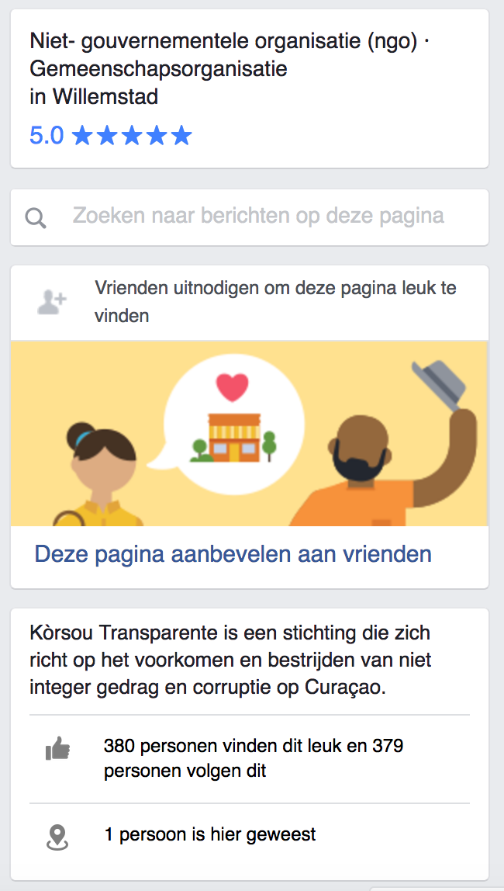
www.facebook.com/KorsouTransparente. 1212 Followers

Slide 5
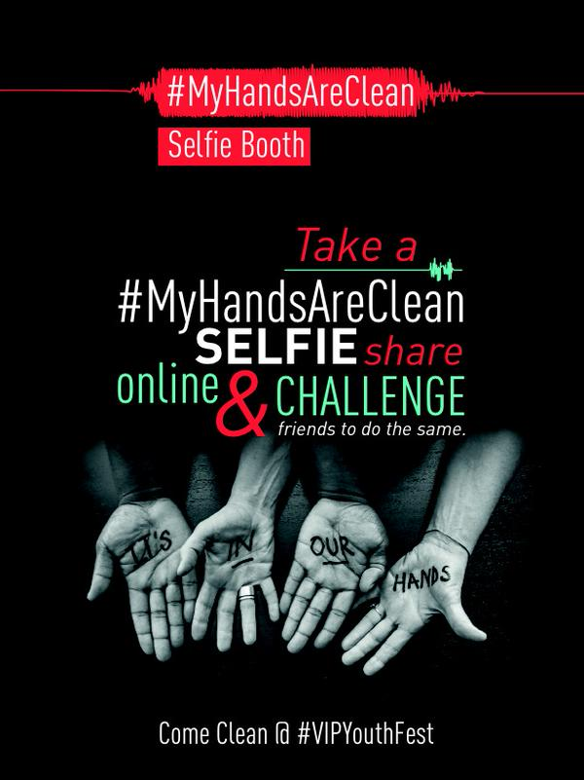
“My Hands Are Clean” campaign
Non-governmental organisation which monitors incidents of corruption that involve public resources
Proven Concept
www.corruptionwatch.org.za/cw-youth-campaign-my-hands-are-clean/

Slide 6
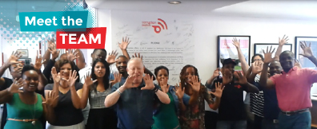
Collaboration FKT & Corruption Watch SA
Skype sessions with their campaigning team
Shared knowledge, lessons learned and… ALL their artwork
Be inspired: http://www.corruptionwatch.org.za/

Slide 7
Concept
Social Media Activation
Event
Song

Slide 8
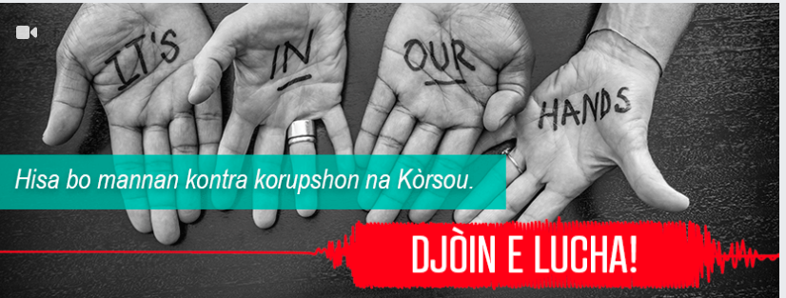
Social Media Activation Twibbon Campaign

Slide 10
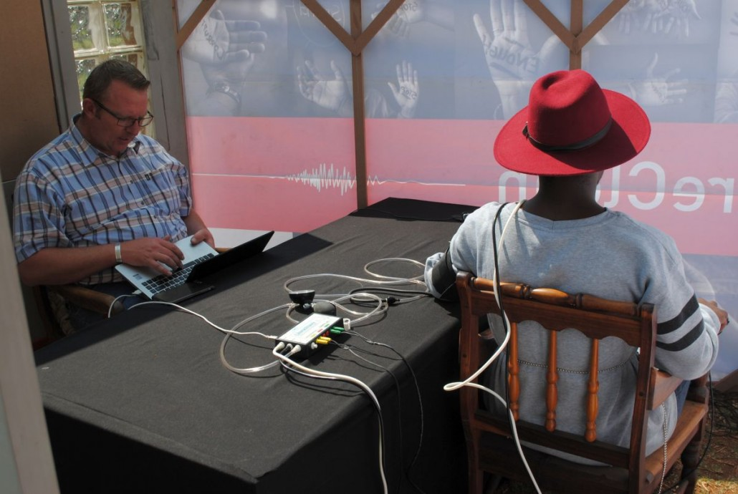
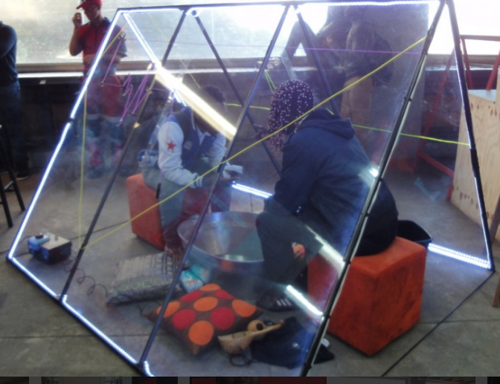
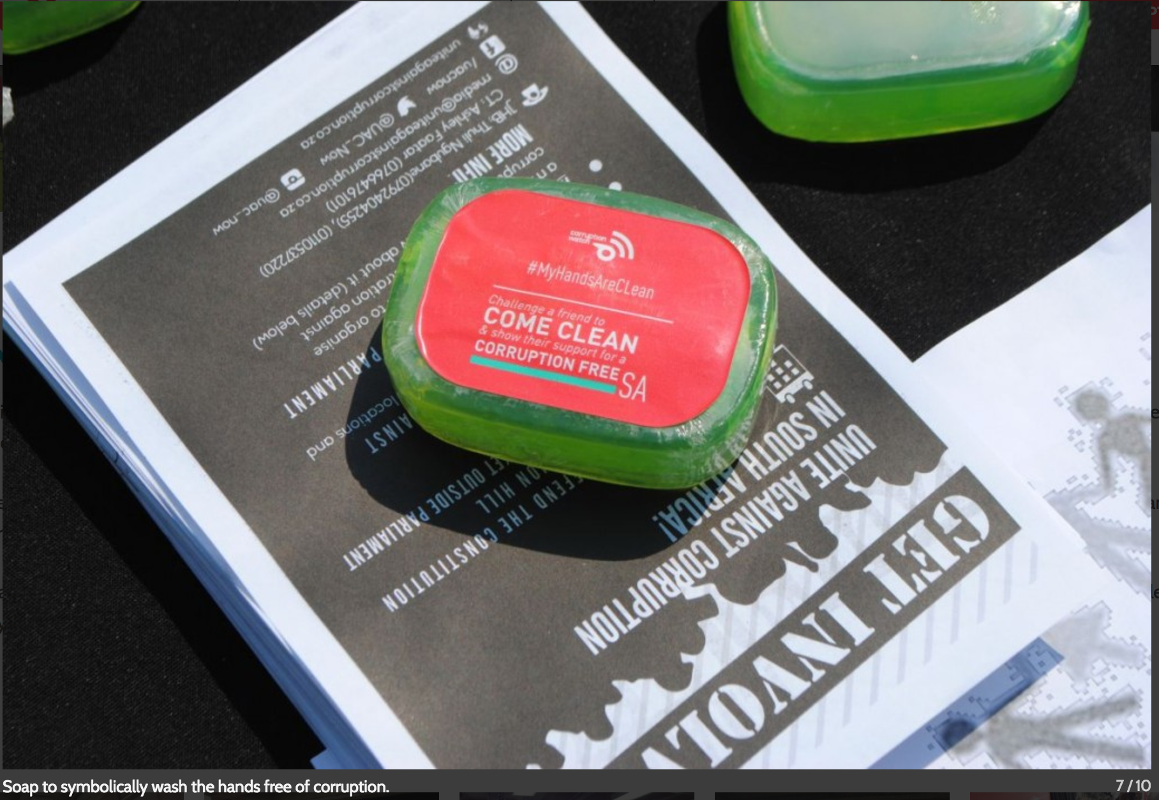
Event
Integriy test
Lie detector

Slide 11
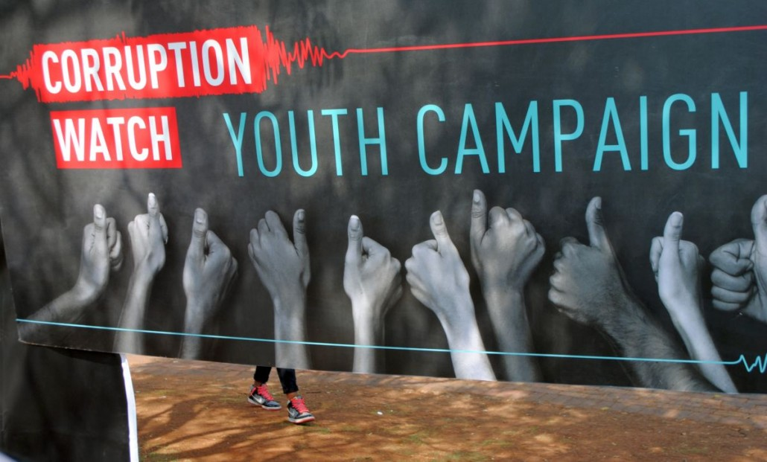
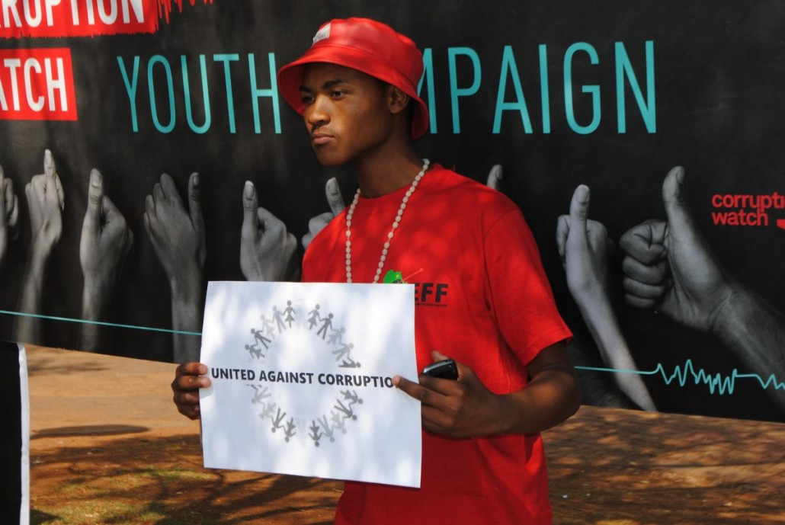
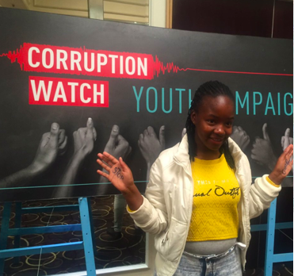
Students took the bribe detector test, and pledged to not get involved in corruption

Slide 12
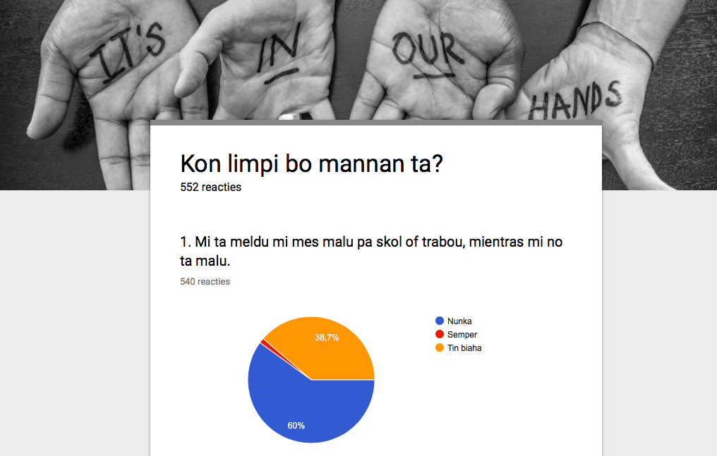
Integrity test

Slide 13
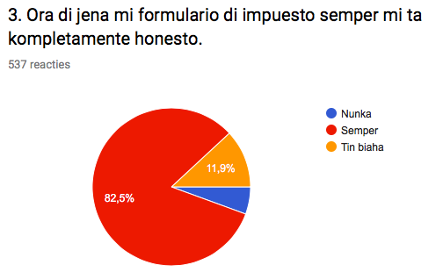
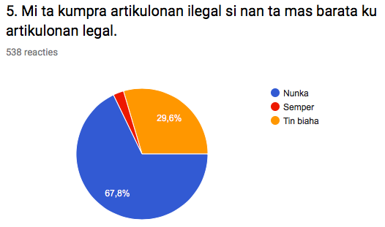
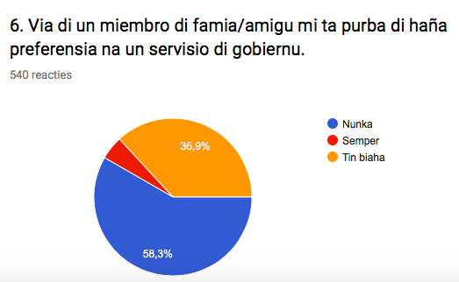

Slide 14
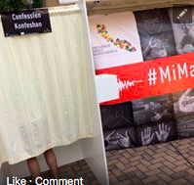
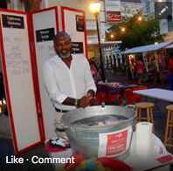
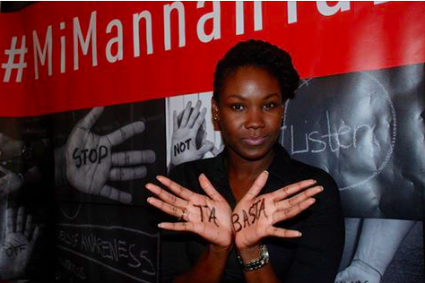
#Mi Mannan ta Limpi Raise your hand against corruption Nominate your friends to raise their hands, too, and join our movement!

Slide 15
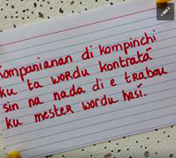
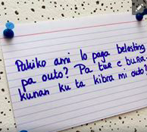

Slide 17
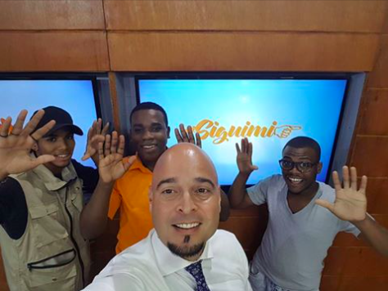
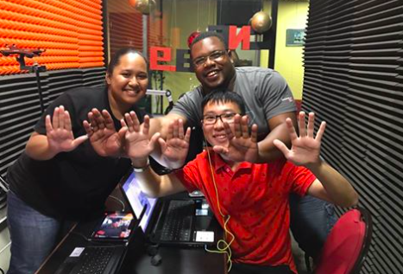
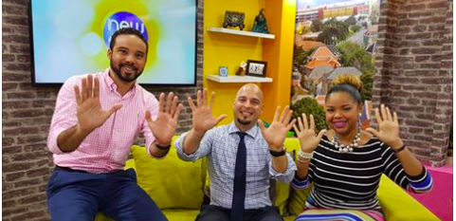

Slide 18
