Slide 2
LONG WALK TO
GOOD GOVERNANCE

Slide 3
A NASTY REALITY

Slide 4
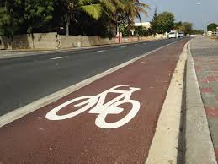
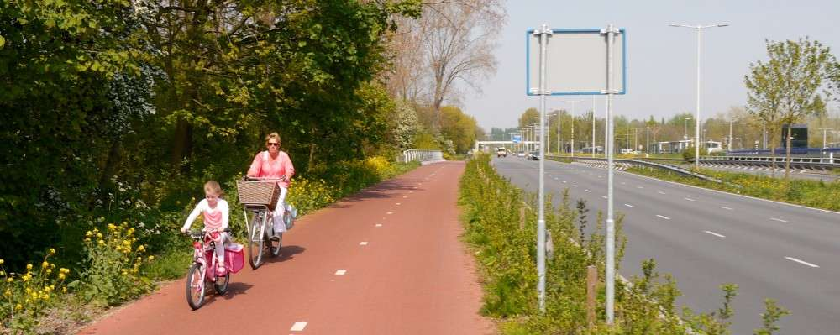

Slide 5
A NASTY REALITY

Slide 6
Insight 1
‘General’ practice & huge difference between ideal (Report Quality) and reality
Good governance
&
the political reality

Slide 7
Insight 2
Huge difference between promises to saveguard general interests and the selfish quest for material improvement for friends & family
25 years Status Aparte,
a politician’s paradise

Slide 8
Insight 3
Individuals can’t fight organizations
Creation of QGFA
Bad governance, organized by
political parties in the
government, can only be
overcome by the organization
of good-willing citizens.
Important statement in Report Quality

Slide 9
Insight 4
3 MAIN AREAS OF BAD GOVERNANCE
Political patronage
Deficient financial administration
Failed and/or suspicious projects
Various reports (Personnel & Fin. Adm.)
Insight 5 → Huge cost of bad governance

Slide 10
FINANCING BAD GOVERNANCE-1 (BEFORE CAft)
GOV. DEP. & SIGNIFICANT BUDGET DEFICITS
STAND STILL + EVER INCREASING LOANS & INTREST
Political patronage
- Personnel
- Properties
- Projects
Deficient financial administration
- Departmental chaos
- Complete lack of control
- No accountability
Failed and/or suspicious projects
- Violation of laws
- Suspious procedures
- Large overrun of costs
AFL

Slide 11
FINANCING BAD GOVERNANCE-2 (AFTER CAft)
GOVERNMENT DEPARTMENTS
Education
Social affairs
Health
Justice
Infrastructure
Higher taxes
Political patronage
- Personnel
- Properties
- Projects
Deficient financial administration
- Chaos
- Lack of control
- No accountability
Failed and/or suspicious projects
- Violation of laws
- Suspious procedures
- Large overrun of costs
AFL

Slide 12
DECREASING FUNDING FOR SOCIAL ORGANISATIONS
YEAR | 2014 | 2015 | 2016
Subsidies (no salary!) | 122.234.600 | 82.825.600 | 52.878.000
Source: Budget Aruba 2014, 2015, 2016

Slide 13
FINANCIAL CONSECUENCES OF POLITICAL PATRONAGE: A COMPARISON OF PUBLIC PERSONNEL ARUBA-CURACAO
COUNTRY 2014 | INHABITANTS | TOTAL PUBLIC EMPLOYEES | MINISTER’S OFFICE
ARUBA | 106.795 | 5.757 | 374
CURACAO | 154.843 | 4.617 | 278
OBSERVATIONS | Although Curacao counts almost 50% more inhabitants, Aruba counts over 1.100 public employees more In case Aruba would have the same ratio of public employee/inhabitants like in Curacao (1/33,5), then Aruba (1/18,5) would have 3.200 public employees → 2.500 less… That would save Aruba Afl. 200 million/year

Slide 14
FINANCIAL CONSEQUENCES OF A DEFICIENT FINANCIAL ADMINISTRATION
Audit office → enormous inefficiencies & lack of control → waste!
- Scholarships, Arubus, Airport, etc.
Audit office → lots of irregularities, fraud: significant loss of money
- Laboratory: Afl. 10 million
- Dep. of education: at least Afl. 1 million
HR department → 20 persons average/year with ‘integrity- problems’
ALL advising & controlling institutions since ‘90: change tax-system
- Old, complicated, inefficient, lots of loopholes for tax-evasion → significant loss of money
CAft → new tax-system generates Afl. 100 million EXTRA/year

Slide 15
FINANCIAL CONSEQUENCES OF FAILED AND/OR SUSPICIOUS PROJECTS : OVER AFL. 1 BILLION/31 YEARS?
- Aruven - Ates project - Interbank/FCCA
- Dutchco - Race-track - FDNSN
- Sace - Interbank/CSS - Dump
Radar - ‘Air- & Sea-letters’ - Trias resort
- Airport - Aruba Bunita NV - PPP-projects
- Air Aruba - Bushiri Hotel - Bo Aruba
- Port - Ostrich project - Lotto pa Deporte
- Postoffice - Bushiri hotel - Hedge-deal
Setar/Fabela - Dividend special - CITGO → ???
+ Countless other projects characterized by suspicious procedures & heavy cost overruns
ONLY Sace (Afl. 200 million) + Hedge-deal (over Afl. 250 million) + Dump (Afl. 28 million) costed Aruba allready ± Afl. 0,5 billion
MIN. AFL. 1 BILLION IN 31 YEARS = AVERAGE ± AFL. 30 MILLION/YEAR

Slide 16
THE MINIMAL COST OF BAD GOVERNANCE IN ARUBA -2017
# | DESCRIPTION | Afl. Million
1 | Unnecessary direct cost of excess government personnel | 200
2 | Deficient financial administration, including tax evasion: | 100
3 | Failed and/or suspicious government projects | 30
 | TOTAL DIRECT MINIMAL AVERAGE COSTS OF BAD GOVERNANCE | 330
4 | Intrest payments (total Afl. 215 million/year) because of debts, for an important part as a result of bad governance | 120
 | TOTAL MINIMAL COSTS OF BAD GOVERNANCE IN 2017 → UNSUSTAINABLE! | 450
 | TOTAL ARUBAN BUDGET | 1.350
Conclusion → Transition to Good Governance → REVERSAL of money flow

Slide 17
GOOD GOVERNANCE
GOVERNMENT DEPARTMENTS
Education
Social affairs
Health
Justice
Infrastructure
Lower taxes
Political patronage
- Personnel
- Properties
- Projects
Deficient financial administration
- Caos
- Lack of control
- No accountability
Failed and/or suspicious projects
- Violation of laws
- Suspious procedures
- Large overrun of costs
AFL

Slide 18
CHANGE OF PARADIGM
Good governance = Bad politics → Good politics = Bad governance
NOT SUSTAINABLE!
Good governance = the best politics Sustainable
In order to realize good governance, it is inevitable to recognize the workings of bad governance and to repair/eliminate all the shortcomings → PRESENTATION DAY 2

